Slide 1
MODULE – II
VERBAL AND NONVERBAL OF COMMUNICATION

Slide 2
VERBAL AND NON-VERBAL COMMUNICATION
VERBAL COMMUNICATION
1- INTRODUCTION :- All forms of communication can be categorized as either verbal or nonverbal. In turn, both verbal and nonverbal communication can be subdivided into either vocal or non vocal. Much of the communication that takes place between people is verbal; that is, it is based on language.
Verbal communication of the vocal category includes spoken language.
Non vocal verbal communication involves written communication as well as communication that is transmitted through transmitted through sign language, finger spelling, Braille, or other similar alternatives to verbal language.

Slide 3
The word ‘verbal means related to words and the use of words. Only man is able to use words that make language. We know that the process of communication involves the use of common set of symbols, that is why all serious or formal communication is the words. These words may be spoken or written. Spoken communication or the communication employing speech is known as Oral Communication.
VERBAL COMMUNICATION: ORAL – We know that speech comes first and writing comes later and therefore, it is worthwhile to deal with oral communication first and written communication later. Man learn speaking much before writing. In the same manner, in an organization people speak much more than they write. There are many occasion, both in formal and informal when the same happen and that is why communication becomes conversational in nature.

Slide 4
LIMITATIONS OF ORAL COMMUNICATION –
(i) - Oral messages cannot always be retained in listener’s memory. The speaker himself may always not recall what he actually said or meant.
(ii) – In the absence of record, oral messages do not have legal validity.
(iii) – Oral communication may not always be time saving, sometimes meeting go on and on for a long time without arriving at any satisfactory conclusion.
(iv) – If the speaker does not organize his thoughts carefully, oral messages may lead to misunderstanding.
(v) – The length of the message may cause a problem. If the message is long it is not always suitable for oral communication.
(vi) – It becomes difficult to fix responsibility bfor anything going bwrong or for any mistake in oral communication.

Slide 5
ADVANTAGES OF ORAL COMMUNICATION –
(i) – In oral communication the speaker has the advantage of understanding the group he is addressing. He can immediately understand the group’s reaction and can arrive at a satisfactory conclusion.
(ii) – The most important advantage of oral communication is that it gives immediate feedback to the participants in the communication, when engaged in discourse with somebody we can ask for clarification or further elaboration, justification etc.
(iii) – Oral communication saves time and creates a conductive atmosphere in an organization . It brings the superiors and subordinates closer.
(iv) – Oral communication also gives the speaker an opportunity to correct himself and make himself clear by changing his voice, tone, pitch etc.

Slide 6
VERBAL COMMUNICATION: WRITTEN –
Written communication involves any type of interaction that makes use of the written word. It is one of the two main types of communication, along with oral/spoken communication. Written communication is very common in business situations, so it is important for small business owners and managers to develop effective written communication skills. Some of the various forms of written communication that are used internally for business operations include memos, reports, bulletins, job descriptions, employee manuals, and electronic mail. electronic mail, Internet Web sites, letters, proposals, telegrams, faxes, postcards, contracts, advertisements, brochures, and news releases.

Slide 7
While oral communication comes naturally and spontaneously to man, written communication requires a lot of efforts but one thing is clear, whatever has been written, unless destroyed becomes permanent. Words spoken are, however, likely to be forgotten but written communication is indispensable.
LIMITATIONS OF WRITTEN COMMUNICATION –
(i) – It is time consumable, immediate feedback is not possible.
(ii) – It is costly in terms of money and time.
(iii) – It becomes ineffective in the hands of those who are poor in expression.
(iv) – It builds up unmanageable piles of paper and files which cost a lot to the organization.

Slide 8
ADVANTAGES OF WRITTEN COMMUNICATION –
(i) - It provides us records, references etc. on which important decision rests.
(ii) – It gives the legal defense to the organization through records, lectures and instructions etc.
(iii) – it builds up the good image of the company.
(iv) – It is permanent and responsibility can be easily assigned.
(v) - Language used in written communication is less subject to change
(vi) - Can be reviewed when required over a period of time
(vii) - Less likely to be misunderstood in case of doubt they can be read again
(viii) - Information can be disseminated widely with the help of printing and duplicating machines

Slide 9
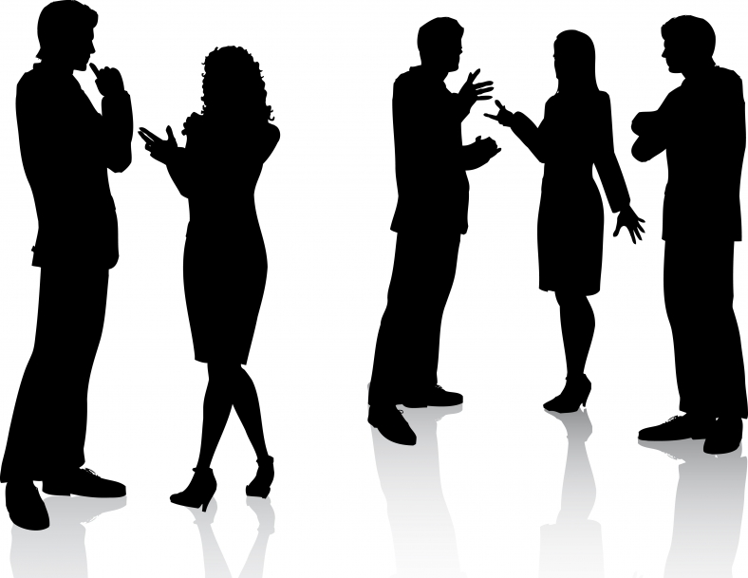
NON-VERBAL COMMUNICATION

Slide 10
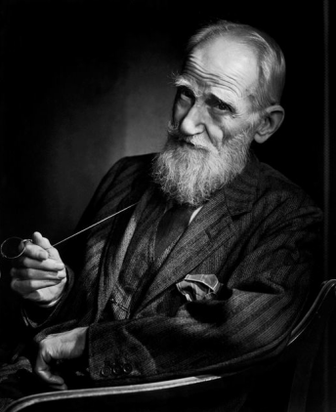
"I am the most spontaneous speaker in the world because every word, every gesture, and every retort has been carefully rehearsed.“
Non verbal communication means communication without words. It is a process of communication through sending and receiving wordless messages.
Before moving forward, let’s keep in your mind that verbal communication and nonverbal communication are interconnected and they operate together in communication.
George Bernard Shaw

Slide 11
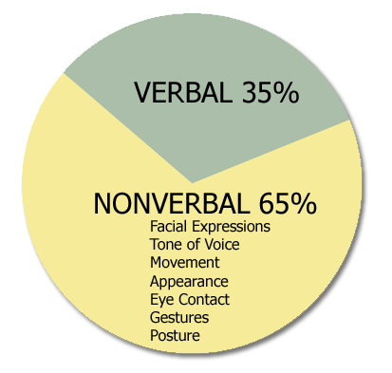
Verbal and non verbal are all types of communication. But the difference between them is that we use our voice in verbal communication and we use body signs in non-verbal communication. Verbal & nonverbal Communication plays an important role in how people interact with one another. People are using around 35% verbal communication and 65% nonverbal communication in daily life. Nonverbal communication has also cultural meaning.
“The most important thing in communication
is to hear what isn't being said.”
Peter F. Drucker

Slide 12
FORM OF NONVERBAL COMMUNICATION\
Eye Contact
Voice Modulation
Gestures
Body language
Posture
Facial Expressions
Haptics or Touch
Personal Space

Slide 13

EYE CONTACT
Eye contact, a key characteristic of non-verbal communication, expresses
much without using a single word. In American culture, maintaining eye contact
shows respect and indicates interest. Eye contact also establish the nature of a
relationship. Eyes, the ‘portals of the soul’, communicate fundamental messages,
sometimes consciously, sometimes unconsciously. There are numerous messages in
western culture relating to eye contact.
Eye contact, or direct gaze, means different things to different people. Euro-American,
Saudi Arabian, Korean and Thai people tend to
regard a direct gaze as a desirable characteristic
indicating openness and honesty. Conversely, an
averted gaze can be construed
as suggesting dishonesty or shiftiness.

Slide 14
In other cultures, however, such as Japanese, Mexican, West African, direct eye
contact may be considered rude, while an averted gaze indicates respect . There is
obvious potential for misunderstanding here. Gaze behavior may also be linked to
‘love at ﬁrstsight’, although Fisher takes a somewhat unromantic view of this
phenomenon.
In some cultures direct eye contact implies the listener is concentrating on what
is being said, while in others (e.g. Japanese) concentration is indicated by an averted
gaze, or closed or half-closed eyes . An apparently universal phenomenon is the
‘eyebrow ﬂash’ — a lifting of the eyebrows when meeting or acknowledging someone .

Slide 15
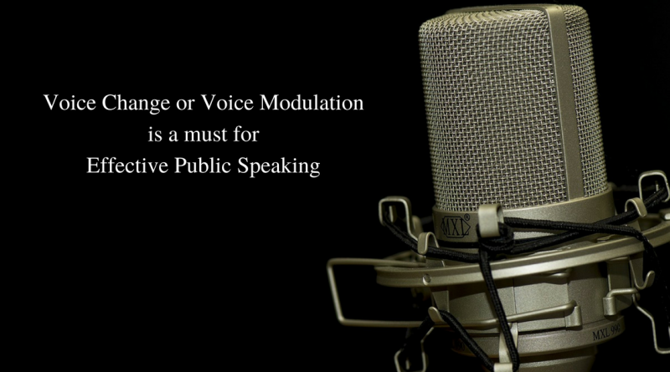
VOICE MODULATION
The quality of our voices can surprise us. If you hear an audio recording of yourself,
or watch yourself on video, what you hear (and see) may not be what you expect, but
it does give you real feedback on the way you actually behave and how you may
come across to others. Any strangeness you
might feel in this self-perception is caused
by the fact that your voice resonates through
your skull before it reaches your ears,
which makes it sound slightly different from
what you hear on playback or what others hear
the fact that, before the invention of ﬁlm and video, no-one in history had access to a
moving representation of themselves.

Slide 16

A few could afford a portrait, and many
had seen themselves in a mirror, but a
mirror is a 180° distortion of how you
actually appear: stand, for example,
in front of a mirror with someone you
know, and you will see that their
reﬂection while accurate as far as it goes
is not what you see when you look at
them directly.

Slide 17
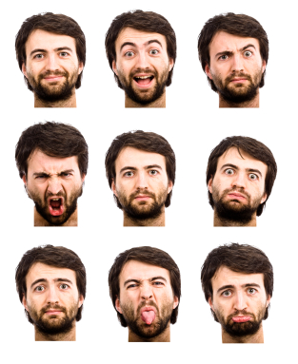
FACIAL EXPRESSIONS
Facial expressions are the key characteristics
of nonverbal communication. Your facial
expression can communicate happiness,
sadness, anger or fear. The face reveals
much of our emotional disposition, and
there are strong cultural and social messages
involved in suppressing or expressing those
emotions.

Slide 18
In Japanese culture, and to a lesser extent British culture, great value is placed on not
revealing emotions, thereby demonstrating the desired characteristics of self-control In
cultures characterized by more mobility of expression, such as the North American or
Australian cultures, facial immobility is a clue to high-status individuals, whose
behavior contrasts with that of others, specially with children, slaves and women. High
Status people thus rarely smile and their voices tend to be pitched lower, while those of
their subordinates are pitched higher; they are looked at by but rarely look at their
subordinates; and touch, but are rarely touched by, their subordinates.

Slide 19
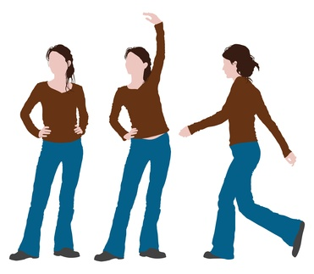
POSTURE
Posture and how you carry your self tells a lot about you.
How you walk, sit, stand or hold your head not only
indicates your current mood, but also your personality
in general.
e.g. If you cross your arms while standing,
you indicate that you may be closed off and defensive.
Meanwhile, walking with your head down and avoiding
eye contact with others may indicate shyness.

Slide 20

HAPTIC OR TOUCH
Haptic communication is communicating
by touch. Touch or Haptics is the
characteristic of nonverbal communication
and used when we come into physical
contact with other people.
e.g. We use handshakes to gain trust and
introduce ourselves.

Slide 21
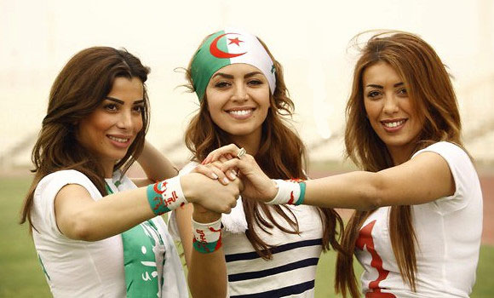
GESTURE
A gesture is a characteristic of
nonverbal communication in
which visible body actions
communicate particular message.
Gestures include movement of
the hands, face, or other parts
of the body.

Slide 22
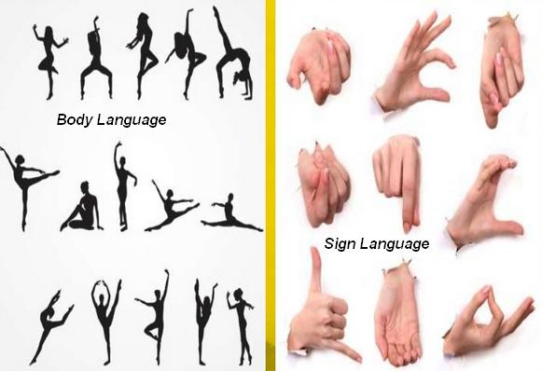
BODY LANGUAGE

Slide 23
Body language is a language in which physical behavior, as opposed to words, is used
to express feelings. Such behavior includes facial expressions, body posture, gestures,
eye movement, touch and the use of space. Body language exists in both animals and
humans, but this article focuses on interpretations of human body language. It is also
known as kinesics. Body language must not be confused with sign language, as sign
languages are full languages like spoken languages and have their own complex
grammar systems, as well as being able to exhibit the fundamental properties that exist
in all languages. Body language, on the other hand, does not have a grammar and must
be interpreted broadly, instead of having an absolute meaning corresponding with a
certain movement, so it is not a language like sign language, and is simply termed as a
"language" due to popular culture.

Slide 24
In a community, there are agreed-upon interpretations of particular behavior.
Interpretations may vary from country to country, or culture to culture. On this note,
there is controversy on whether body language is universal. Body language, a subset of
nonverbal communication, complements verbal communication in social interaction.
In fact some researchers conclude that nonverbal communication accounts for the
majority of information transmitted during interpersonal interactions. It helps to
establish the relationship between two people and regulates interaction, but can be
ambiguous. Hence, it is crucial to accurately read body language to avoid
misunderstanding in social interactions.ing.

Slide 25
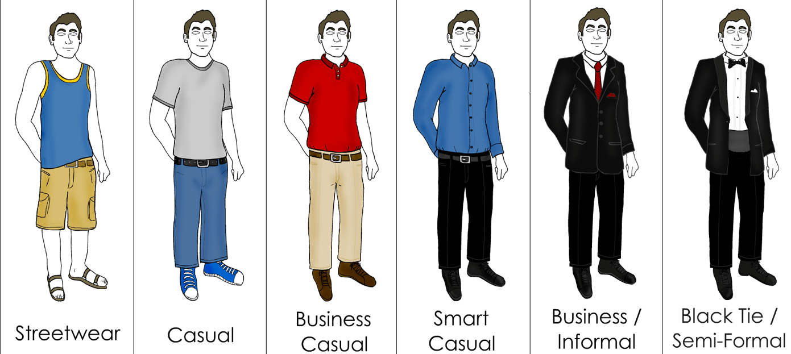
DRESS CODE

Slide 26
DRESS CODE
Dress is considered an aspect of non-verbal communication and has social significance
For the audience. Dress also includes the things that people wear such as jewelry, ties,
handbags, hats and glasses. Clothing conveys nonverbal clues about a speaker's
personality, background and financial status. Your clothing style can demonstrate your
culture, mood, level of confidence, interests, age, authority, values and sexual identity.
Consider how clothing style might send a negative message. A sloppy appearance,
messy hair and wrinkled clothes sends the message, "I don't care," while appropriate
attire demonstrates the importance of the occasion .

Slide 27
Let see some most common gestures

Slide 28
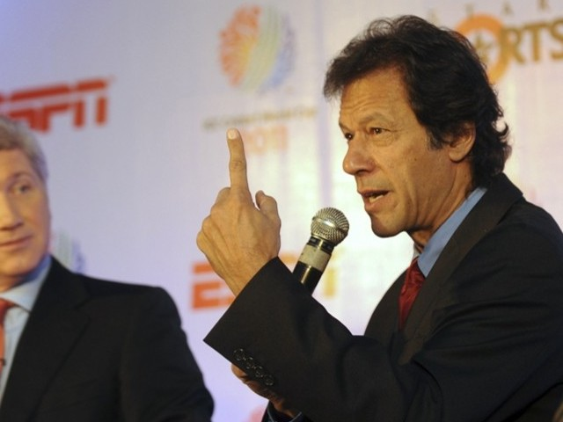

Slide 29
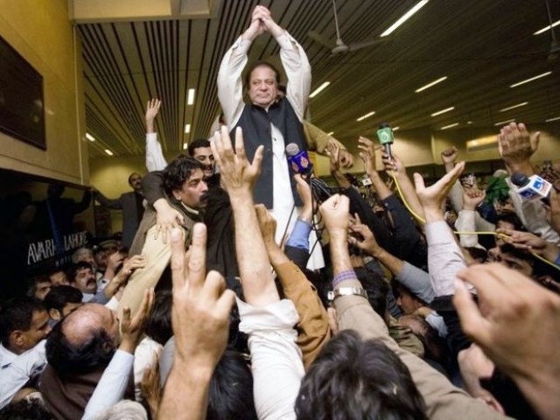

Slide 30
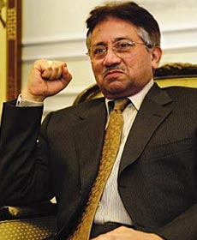

Slide 31
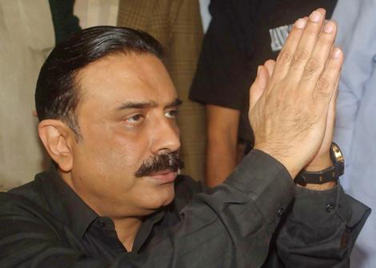

Slide 32
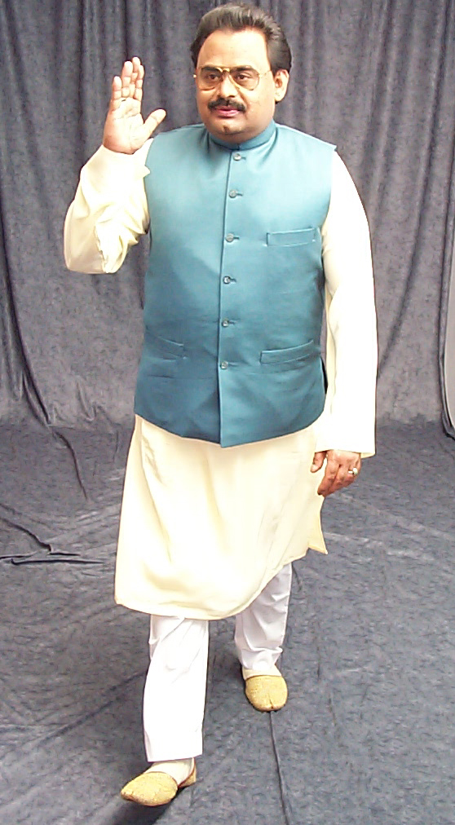

Slide 33

Personal space
Personal space is your "bubble" - the space you place between yourself and others. This invisible boundary becomes apparent only when someone bumps or tries to enter your bubble.

Slide 34
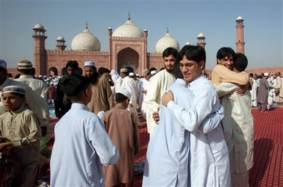
Nonverbal Communication Around the World
Nonverbal Communication in Pakistan
Expressing happiness, respect and love for others.
Cultural effect

Slide 35

Nonverbal Communication Around the World
Nonverbal Communication in China
The Chinese don't like being touched by strangers. Therefore don’t make any body contact.
Cultural effect

Slide 36

Nonverbal Communication Around the World
Nonverbal Communication in Argentina
A handshake and nod show respect when greeting someone.
Cultural effect

Slide 37

Nonverbal Communication Around the World
Nonverbal Communication in India
Greeting with 'namaste' - placing both hands together with a slight bow is a very common nonverbal communication and shows respect.
Cultural effect

Slide 38

Nonverbal Communication Around the World
Nonverbal Communication in the U.S.A
Quite Informal way of nonverbal communication - A handshake, a smile, and 'hello'.
Cultural effect

Slide 39
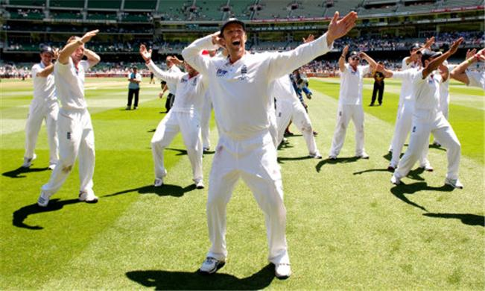
Nonverbal Communication must be understandable
But what the……..is this?
Chicken Dance……☺
Dance is an artistic form of nonverbal communication. But no one really knows what England’s creepy chicken dance is trying to communicate.
I just understand that they are happy.

Slide 40
QUERY !

Slide 41
FORMAL AND INFORMAL CHANNELS TO COMMUNICATION
FORMAL COMMUNICATION
1- INTRODUCTION - In an organization, there are two channels of
communication – formal communication and informal communication. People often
confuse between these two channels, so here we have presented an article which
explains the difference between formal and informal communication network. A
formal channel of communication can be defined as a means of communication that is
normally controlled by managers or people occupying similar position in an
organization. It has been called ‘the main line of organization’s operational
communication’. In this, reports, records, orders, instructions and messages that move

Slide 42
up and down in the hierarchical system. These forms of communication just do not happen by themselves but carefully thought and well designed. Great care is taken in their design and movement.
DIFFERENT CHANNELS OF FORMAL COMMUNICATION –
All formal communications are broadly classified as:
1 - Horizontal communication.
2 – Vertical communication:
(i) Downward communication.
(ii) Upward communication.

Slide 43
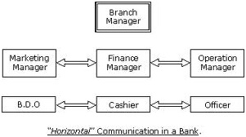
HORIZONTAL COMMUNICATION – The communication between two employees of different departments working at the same level.

Slide 44
ADVANTAGES OF HORIZONTAL COMMUNICATION:
Horizontal communication improves the quality of team work.
Since horizontal communication means better co-ordination of individual effort, it ensures greater efficiency and better results.
Effective horizontal communication helps to eliminate misunderstanding, envy, and petty jealousies among people of equal status.
DISADVANTAGES OF HORIZONTAL COMMUNICATION:
There may be a conflict between horizontal and vertical communication. Horizontal communication takes place more frequently than communication between seniors and juniors. So, a decision taken horizontally may go against some instructions given by senior.
At higher managerial levels horizontal communication becomes difficult when people engaged in specialised jobs use technical languages (Jargons).
Unless horizontal communication is tightly controlled and each person is made actually aware of his responsibilities, a great deal of time may be wasted

Slide 45
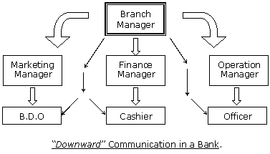
VERTICAL COMMUNICATION – Communication among different levels on the line of authority. The communication between the employees of two different departments working at different levels.

Slide 46
DOWNWARD COMMUNICATION - Traditional type of corporate communication. Downward communication takes place whenever a person belonging to a higher position the line of authority communicates with
a person belonging to the lower levels of the hierarchy.
The communication in which the flow of information
goes from superior to subordinate.
e.g. Staff meetings, interviews, circular or notices, etc.
M.D.
Director
Managers
Officers
Supervisors
Workers

Slide 47
UPWARD COMMUNICATION - Flow of communication from lower levels to higher levels. Upward communication is essential to managers informed about the progress of the work. In some organisations
‘open door’ policy is followed. The communication
in which the flow of information goes
from subordinate to superior authority.
e.g. Supervisors advising officers.
M.D.
Director
Managers
Officers
Supervisors
Workers

Slide 48
INFORMAL COMMUNICATION - The communication which does not follow any pre-defined channel for the transmission of information is known as informal communication. This type of communication moves freely in all directions, and thus, it is very quick and rapid. In any organization, this type of communication is very natural as people interact with each other about their professional life, personal life, and other matter. The informal communication is of four types:
e.g. Sharing of feelings, casual discussion, gossips, etc.
DIFFERENT CHANNELS OF FORMAL COMMUNICATION –
Single Strand Chain: The communication in which one person tell something to another, who again says something to some other person and the process goes on.
Cluster Chain: The communication in which one person tells something to some of its most trusted people, and then they tells them to their trustworthy friends and the communication continues.

Slide 49
Probability Chain: The communication happens when a person randomly chooses some persons to pass on the information which is of little interest but not important.
Gossip Chain: The communication starts when a person tells something to a group of people, and then they pass on the information to some more people and in this way the information is passed on to everyone. Informal communication occurs when people come together and talk about their working conditions, family, co-workers, etc. rumour, gossip, etc. are the examples of the informal communication.

Slide 50
S.No. | Basis for Comparison | Formal Communication | Informal Communication
1. | Meaning | A type of verbal communication in which the interchange of information is done through the pre-defined channels is known as formal communication. | A type of verbal communication in which the interchange of information does not follow any channels i.e. the communication stretches in all directions.
2. | Another Name | Official Communication | Grapevine communication
3. | Reliability | More | Comparatively less
4. | Speed | Slow | Very Fast
5. | Evidence | As the communication is generally written, documentary evidence is present. | No documentary evidence.

Slide 51
6. | Time Consuming | Yes | No
7. | Advantage | Effective due to timely and systematic flow of information. | Efficient because employees can discuss work related problems, this saves time and cost of the organization.
8. | Disadvantage | Distortion due to long chain of communication. | Spread of rumors
9. | Secrecy | Full secrecy is maintained. | It is difficult to maintain the secrecy.
10. | Flow of Information | Only through predefined channels. | Can move freely.

Slide 52
QUERY !

Slide 53
LESSON – 3
QUALITIES OF GOOD COMMUNICATION
SEVEN C’S OF COMMUNICATION
1- INTRODUCTION AND DEFINITION –The ability to communicate is an essential life skill and one that can be continually developed. Even if you are a naturally good communicator, there are always opportunities and ways to enhance your communication skills. Individuals who are good communicators find it easy to develop empathy and trust with others. These people adapt their style of communication to suit the audience and situation they are presented with. They are also called the seven Cs of communication, which are given below-
1.Completeness 2.Conciseness 3.Clarity 4.Correctness
5.Consideration 6.Courtesy 7.Concreteness

Slide 54
COMPLETENESS
Every communication must be complete and adequate. Incomplete messages keep the receiver guessing, create misunderstanding and delay actions.
Every person should, therefore, be provided with all the required facts and figures.
e.g. When factory supervisor instructs workers to produce, he must specify the exact size, shape, quality and cost of the product. Any assumptions behind the messages should also be clarified.
While answering a letter, all the questions raised in the letter must be replied.

Slide 55
CONCISENESS –
Conciseness means wordiness, i.e, communicating what you want to convey in least possible words without forgoing the other C’s of communication. Conciseness is a necessity for effective communication. Concise communication has following features It is both time-saving as well as cost-saving. It underlines and highlights the main message as it avoids using excessive and needless words.
  Concise communication provides short and essential message in limited words to
  the audience. Concise message is more appealing and comprehensible to the
  audience. Concise message is non-repetitive in nature.

Slide 56
CLARITY -
Clarity means getting your message across so, the receiver will understand what you are trying to convey. You want that person to interpret your words with the same meaning you have in mind. Accomplishing that goal is difficult because, as you know, individual experiences are never identical, and words have different meanings to different persons. Here are some specific ways to help and make your messages clear:
1. Choose short, familiar, conversational words.
2. Construct effective sentences and paragraphs.
3. Achieve appropriate readability (and listening ability).
4. Include examples, illustrations, and other visual aids, when desirable

Slide 57

. CORRECTNESS -
The term correctness as applied to business
messages means right level of language
and accuracy of facts, figures and words.
If the information is not correctly conveyed,
the sender will lose credibility. Transmission
of incorrect information to superiors will
messages, grammatical errors should also
be avoided. You should not transmit any
message unless you are absolutely sure of
its correctness.

Slide 58

CONSIDERATION -
Consideration means that you prepare every
message with the recipient in mind and try to put
yourself in his or her place. Try to visualize your
readers or listeners with their desires, problems
circumstances, emotions, and probable reactions
to your request. Then handle the matter from their
point of view. This thoughtful consideration is
also called "you-attitude," empathy, the human
touch, and understanding of human nature.
(It does not mean, however, that you should overlook the needs of your
organization.)

Slide 59
CONSIDERATION CONT…
Consideration underlies the other six C's of good business communication You adapt
your language and message content to your receiver's needs when you make your
message complete, concise, concrete, clear, courteous, and correct. However, in four
specific ways you can indicate you are considerate:
Focus on "you" instead of "I" and "we.“
Show reader benefit or interest in reader.
Emphasize positive, pleasant facts.
Apply integrity and ethic

Slide 60

COURTESY -
Courteous messages help to strengthen present business friendships, as well as make
new friends. Courtesy stems from sincere you-attitude. It is not merely politeness with
mechanical insertions of "please" and "thank-you'd." To be courteous, considerate
communicators should follow these suggestions regarding tone of the
communications.
Be sincerely tactful, thoughtful, and appreciative.
Omit expressions that irritate, hurt, or belittle.
Grant and apologize good-naturedly.

Slide 61

CONCRETENESS -
Communicating concretely means being specific, definite, and vivid rather than vague
and general. The following guidelines
should help you compose concrete,
convincing messages:
Use specific facts and figures.
Put action in your verbs.
Choose vivid, image-building words.

Slide 62
QUERY !

Slide 63

THANK YOU !

